Slide 1



Annual Cause Death
ANALYSIS
RIZA NURSYAH

Slide 2

SUBJECT
01
02
03
04
05
Potential Use Case
Data
Analysis &
Data Visualization
Conclusion
Overview
Methodology

Slide 3

Overview
Title:
Analysis of Annual Death Data
Objective:
Understand global death trends, identify the main causes of death, analyze the correlation between causes of death, and examine specific HIV/AIDS fatalities trends in Indonesia.

Slide 4

Potential Use Case
Time trend analysis
Analysis of the main causes of death
Correlation between causes of death
Trends in Deaths due to HIV/AIDS in Indonesia
Trends in Communicable and Non-Communicable Disease Deaths in Indonesia

Slide 5

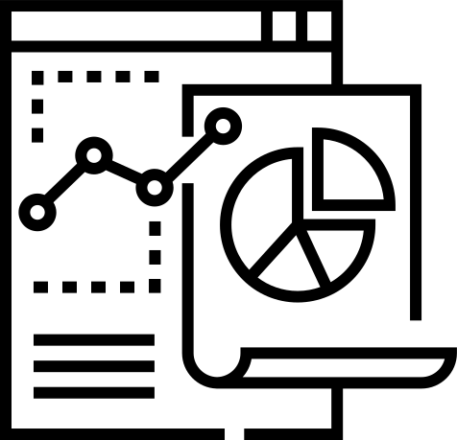


Methodology
Data Collection
Data Analysis
Conduct time trend analysis, identify main causes of death, analyze correlations between causes of death, and examine specific death trends in Indonesia.
Using annual death data from trusted sources like kaggle.
Data Visualization
Data Wrangling
Conduct time trend analysis, identify main causes of death, analyze correlations between causes of death, and examine specific death trends in Indonesia.
Check and clean data from duplicates and missing values, and change the data format as needed.

Slide 6
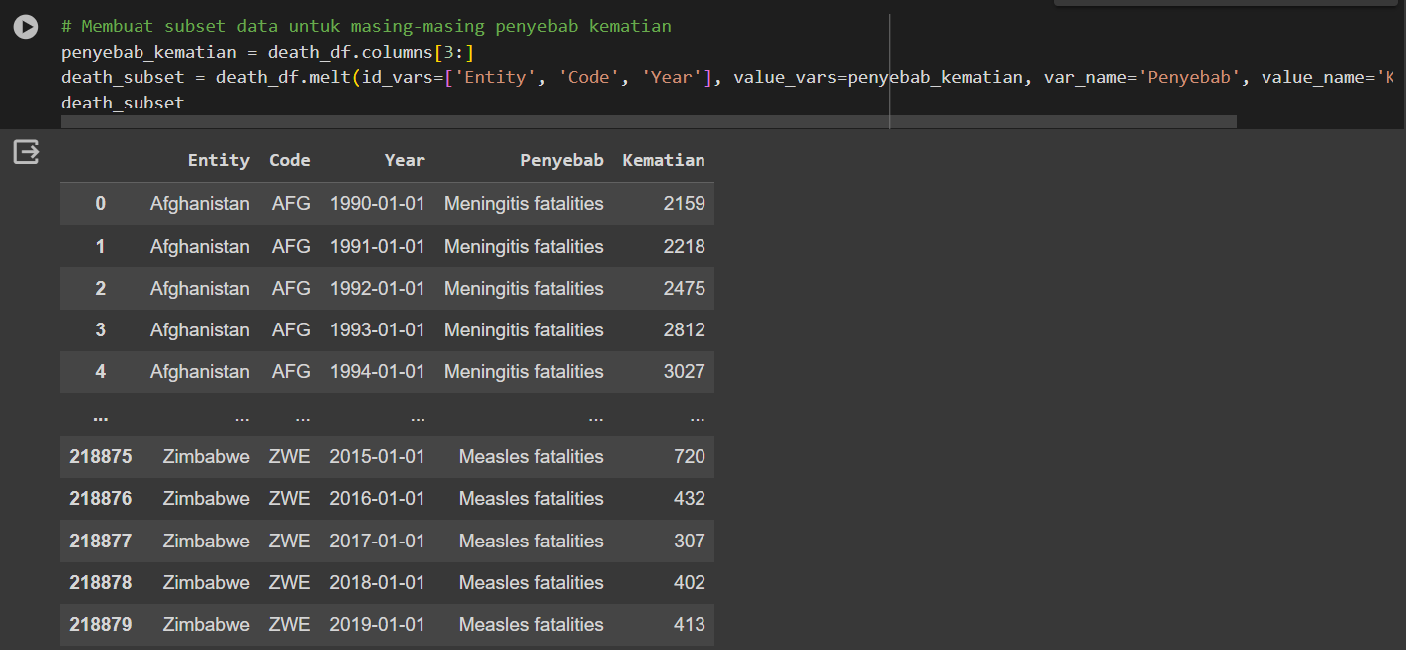
Data Analysis and Visualization
Time Trend Analysis
Look at changes in the number of deaths from year to year for each cause of death

Slide 7
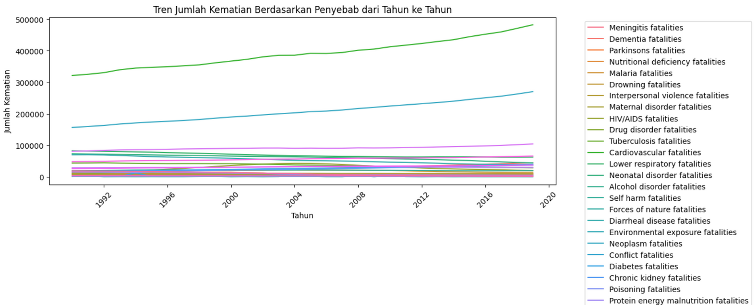
Data Analysis and Visualization
Time Trend Analysis
After visualization, it can be seen that from year to year the highest number of causes of death are ‘Cardiovascular Fatalities’.

Slide 8
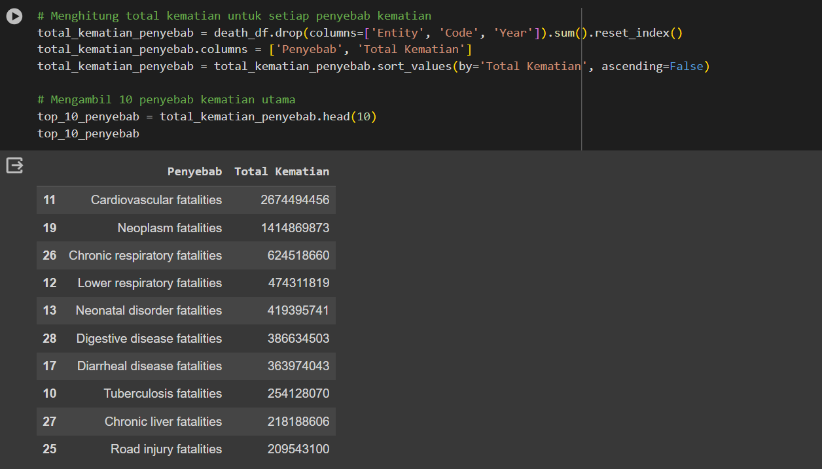
Data Analysis and Visualization
2. Analysis of the main causes of death
Identifying the top 10 causes of death globally.

Slide 9
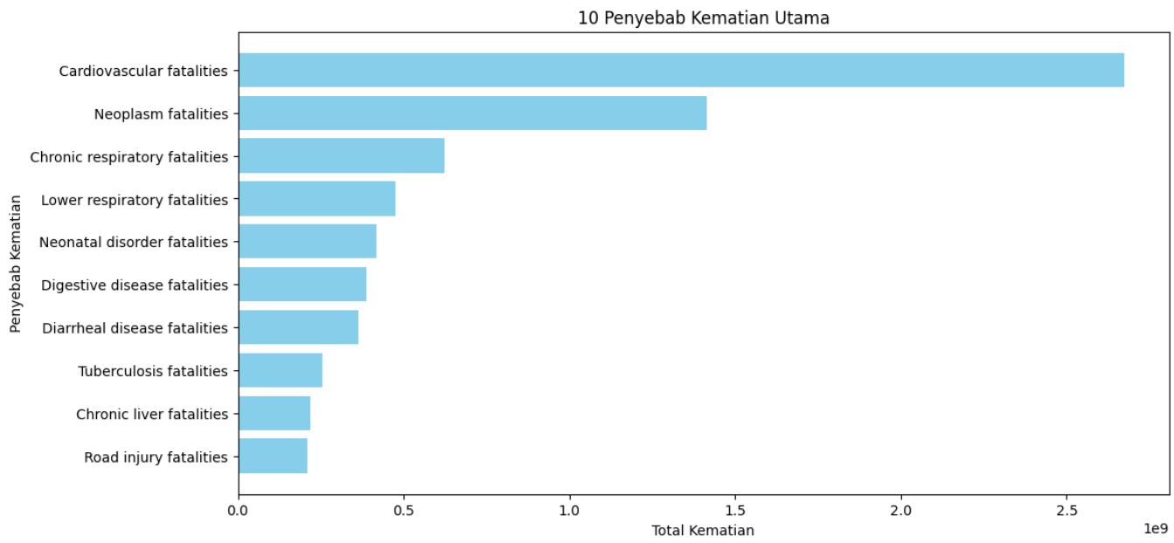
Data Analysis and Visualization
2. Analysis of the main causes of death
After visualization of the top 10 causes of death, it can be seen that the most common cause of death is 'Cardiovascular Fatalities', the same as the first analysis

Slide 10
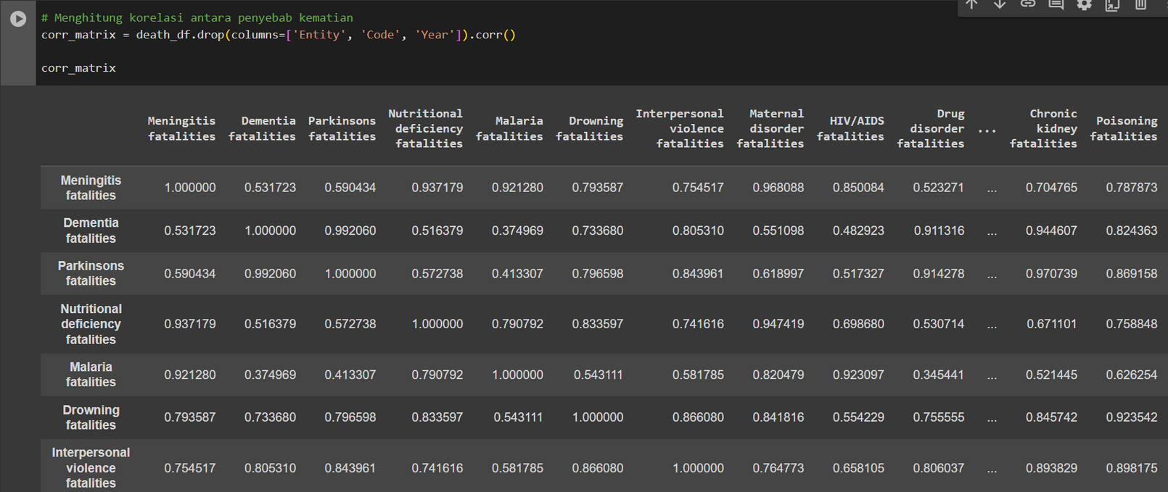
Data Analysis and Visualization
3. Correlation between causes of death
Analyze the correlation between causes of death to see the relationship between them.

Slide 11
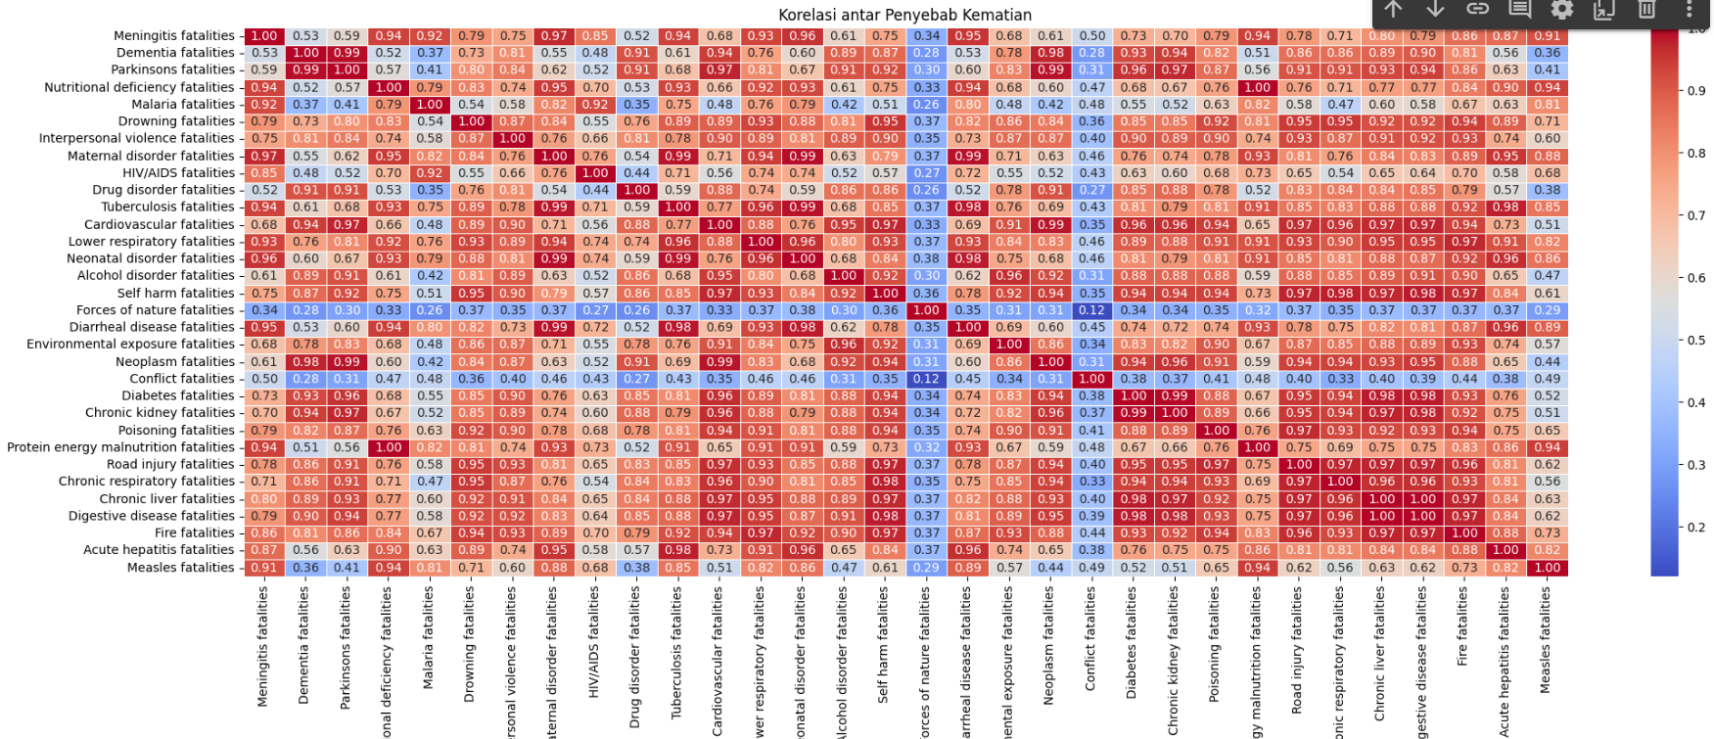
Data Analysis and Visualization
3. Correlation between causes of death
This heatmap table shows that if the value is close to 1.0 then the two variables are correlated or have a relationship. It can be seen in this visualization that there are quite a lot of causes of death that are close to 1.0, which means they are almost or correlated with each other

Slide 12
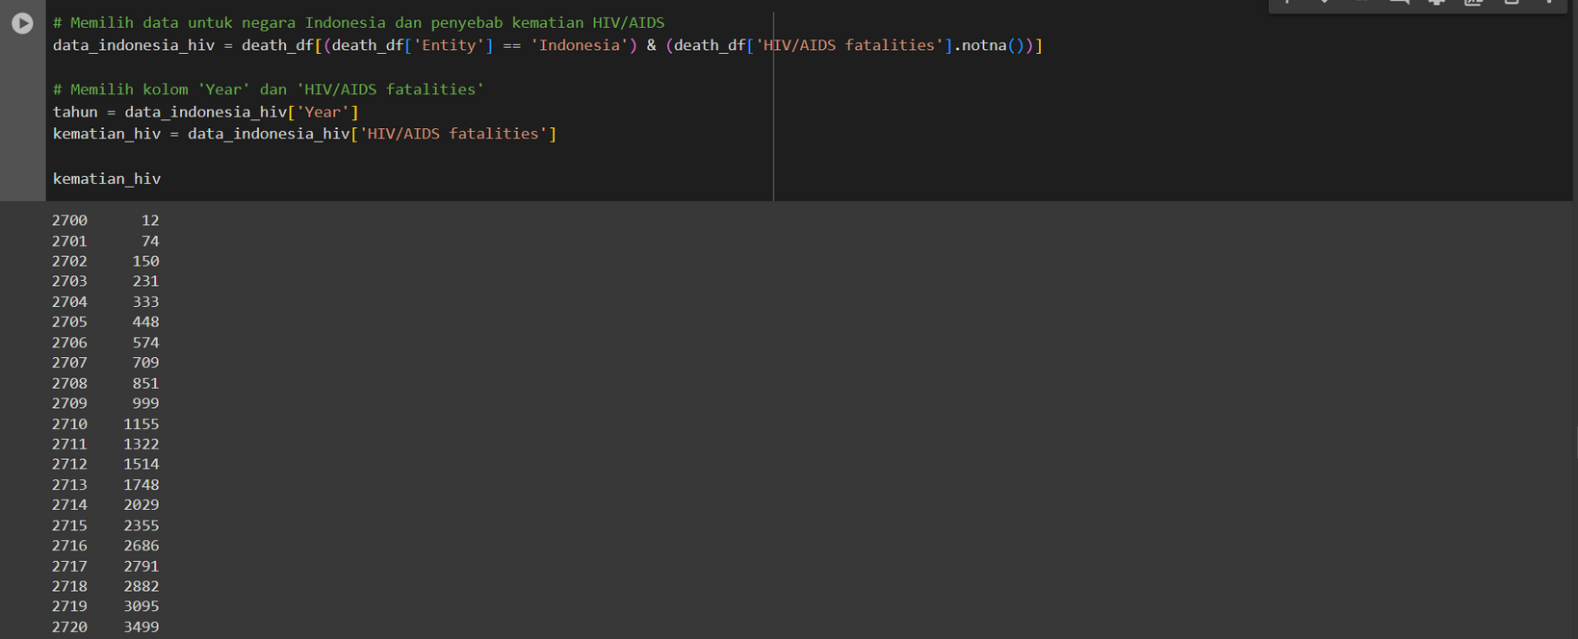
Data Analysis and Visualization
4. Trends in Deaths due to HIV/AIDS in Indonesia
Reviewing trends in deaths due to HIV/AIDS in Indonesia.

Slide 13
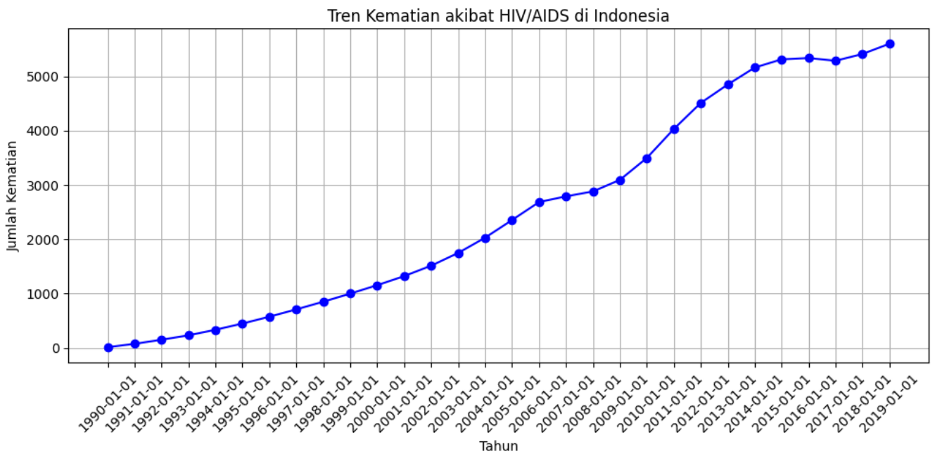
Data Analysis and Visualization
4. Trends in Deaths due to HIV/AIDS in Indonesia
It can be seen that data visualization regarding the causes of HIV/AIDS deaths in Indonesia has increased from 1990 to 2019.

Slide 14
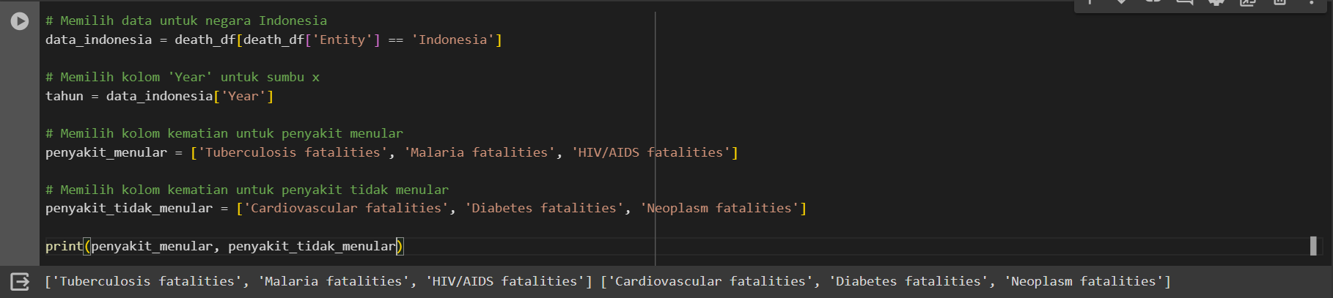
Data Analysis and Visualization
5. Trends in Communicable and Non-Communicable Disease Deaths in Indonesia
Analyzing death trends from infectious and non-communicable diseases in Indonesia. After analysis, it can be seen that the infectious diseases are 'Tuberculosis', 'Malaria' and 'HIV/AIDS'. Meanwhile, non-communicable diseases are 'Cardiovascular', 'Diabetes' and 'Neoplasm'

Slide 15
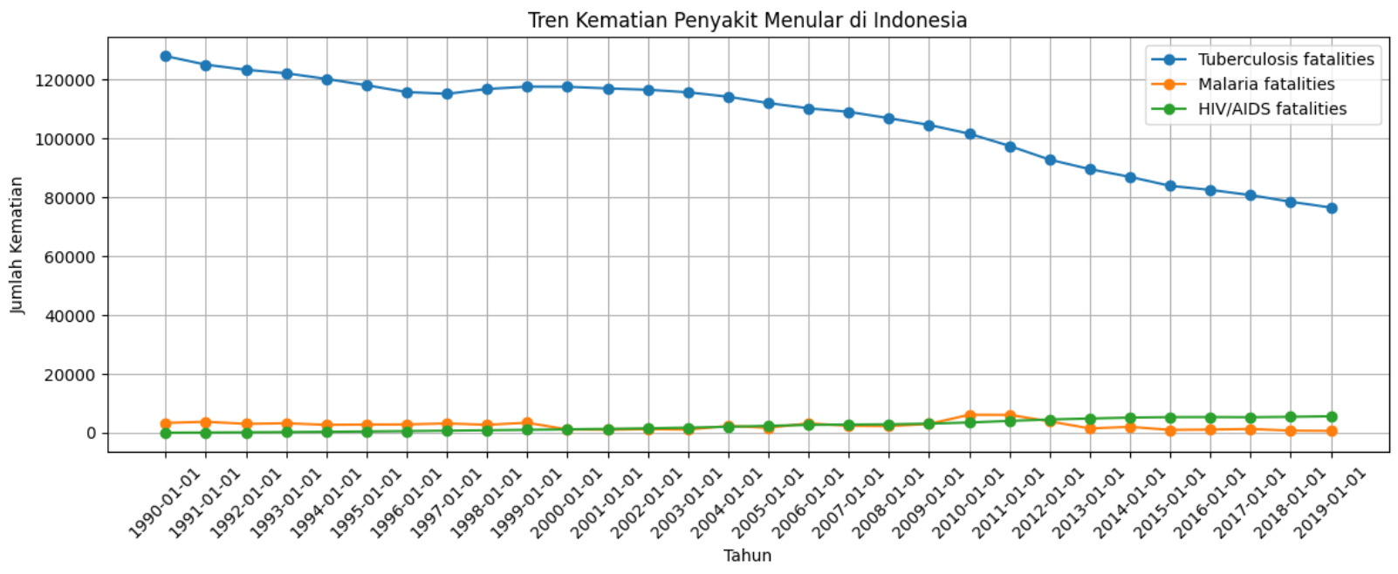
Data Analysis and Visualization
5. Trends in Communicable and Non-Communicable Disease Deaths in Indonesia
Trends in Infectious Diseases
In the visualization of infectious diseases, it can be seen that tuberculosis, which has the highest mortality rate, has experienced a decrease in death rates in Indonesia, while the other two diseases do not appear to have increased or decreased significantly.

Slide 16
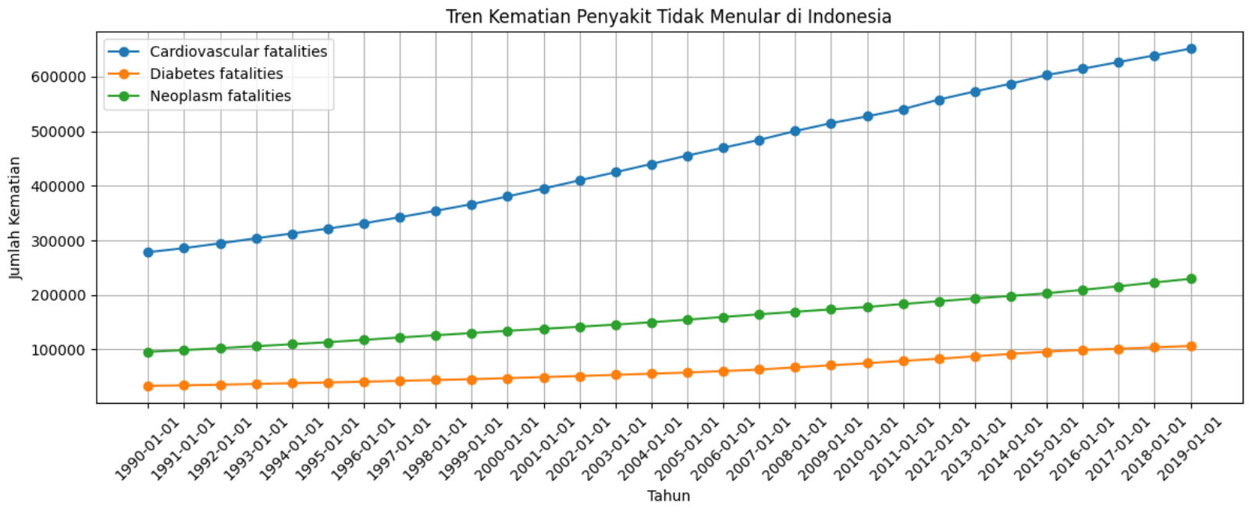
Data Analysis and Visualization
5. Trends in Communicable and Non-Communicable Disease Deaths in Indonesia
Trends in Non-Communicable Diseases
It can be seen that the three causes of death have increased significantly during the period from 1990 to 2019, especially since there has been a very high increase in cardiovascular disease.

Slide 17

Conclusion
Key Findings: Causes Death trends show significant changes from year to year, with several leading causes of death predominant globally.
Implications: This analysis can help in planning more effective health policies, including disease prevention and epidemic control in various countries.
In conclusion, we can understand mortality trends holistically, analyze patterns and factors that influence them, and formulate more effective strategies in managing public health

Slide 18

THANK YOU

